Slide 1
Secure Data Hiding in Image Using Steganography
CAPSTONE PROJECT
Presented By: Sayali Suhas Sumant
College Name & Department : MES Senior College, BCA.

Slide 2
OUTLINE
Problem Statement
Technology used
Wow factor
End users
Result
Conclusion
Git-hub Link
Future scope

Slide 3
Problem Statement
It is difficult in digital communication to ensure message security without attracting attention. Traditional encryption methods are effective, but they also cause suspicion. The goal of this project is to create a steganography system that hides hidden text messages within an image by changing pixel values. A password allows users to securely encode and decode messages, ensuring only authorized access. The technology will preserve image quality while providing a discreet and efficient means of secure communication.

Slide 4
Technology used
Programming Language: Python
Image Processing Library: OpenCV (cv2)
File Handling & OS Interaction: OS module
Data Encoding & Decoding: ASCII Mapping
User Interaction: Command-line Interface (CLI)

Slide 5
Wow factors
Invisible Encryption: The message is hidden within the image without altering its visible appearance, making it undetectable to the human eye.
Password-Protected Decryption: Only users with the correct password can retrieve the hidden message, adding an extra layer of security.
Simple Yet Powerful: Uses basic pixel manipulation instead of complex cryptographic techniques, making it lightweight and efficient.

Slide 6
End users
Corporate Professionals: Businesses needing secure document transmission without traditional encryption methods.
Forensic Experts & Ethical Hackers: To analyze hidden data within images for investigative purposes.
Students & Researchers: Those exploring digital forensics, cryptography, and image processing.

Slide 7
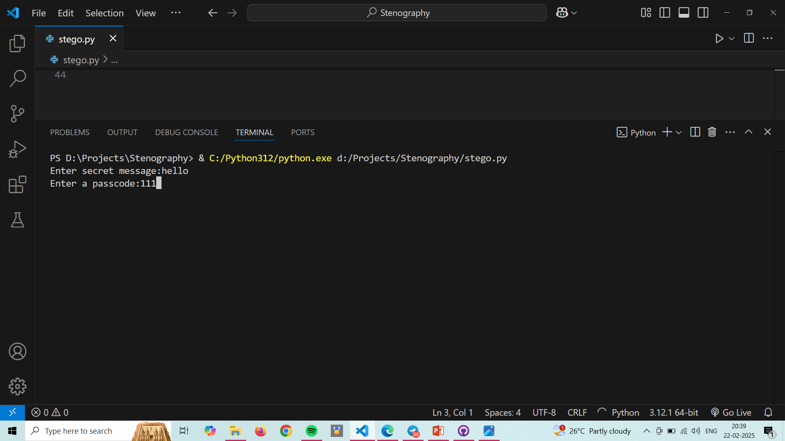
Results 1)

Slide 8
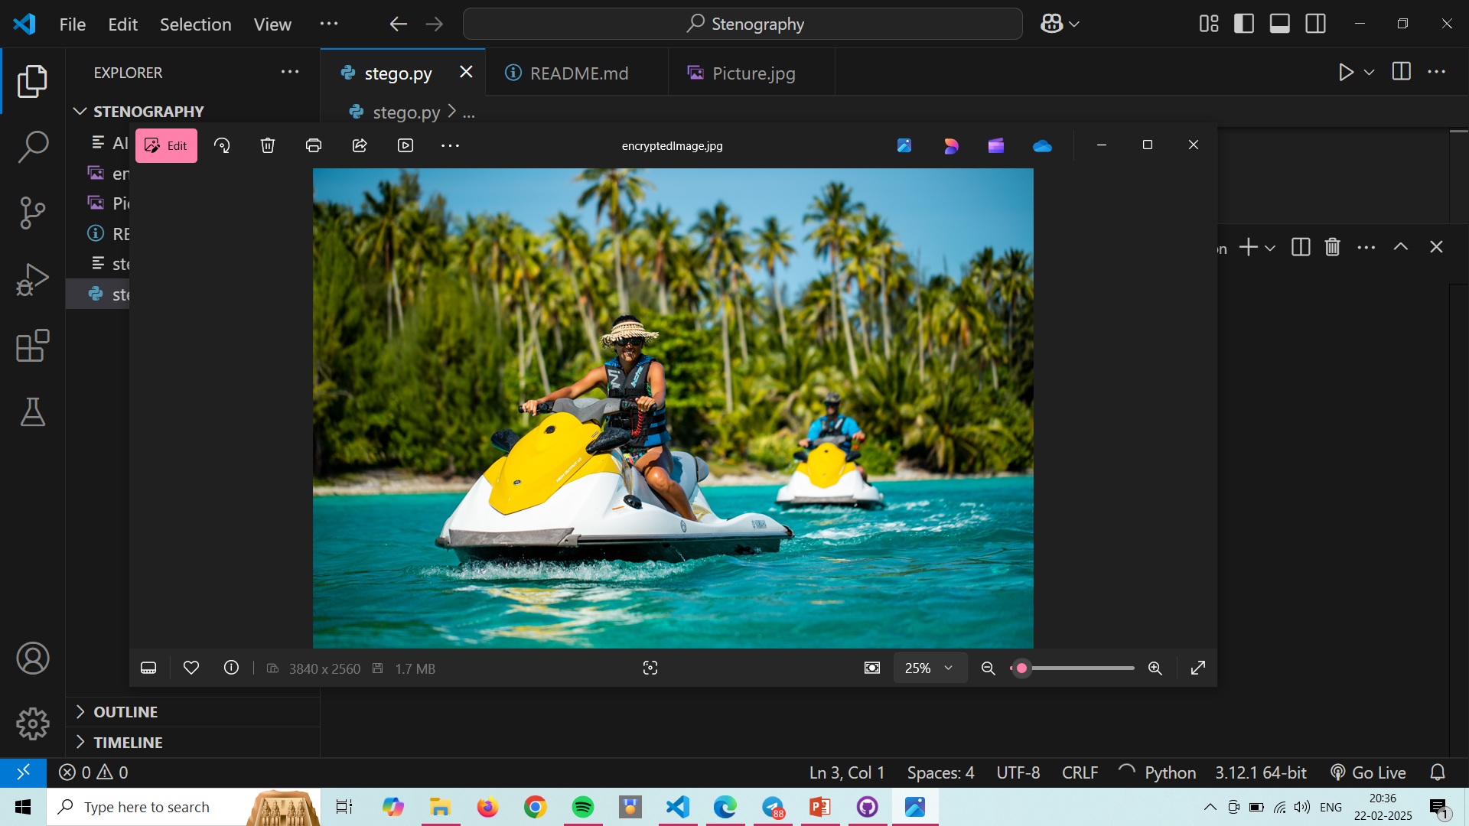
Results 2)

Slide 9
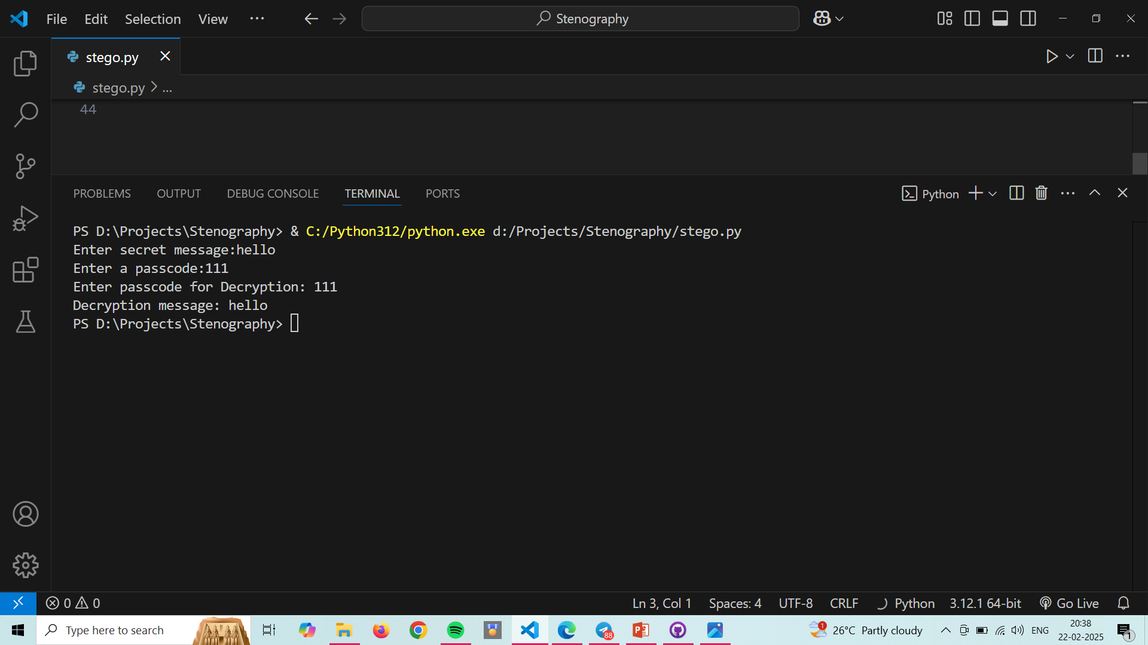
Results 3)

Slide 10

Results 4)

Slide 11
Conclusion
This project showcases a lightweight, efficient image-based steganography technique for secure message hiding and retrieval, integrating password-protected decryption for authorized access, enhancing cybersecurity, confidential communication, and digital watermarking.

Slide 12
GitHub Link
https://github.com/SayaliSumant/Stegnography.git

Slide 13
Future scope(optional)
GUI Implementation: Develop a user-friendly desktop or web interface using Tkinter, PyQt, or
React for better accessibility.
Support for Multiple Image Formats: Extend compatibility to PNG, BMP, and GIF to prevent data loss
in compression.

Slide 14
THANK YOU

